Slide 1
Mini-Project: SQL
Where to implement renewable energy in the world
SQUELISTAS
Team: Ana, Ettore & Miriam

Slide 2
Goal of the Analysis
Stakeholder: Renewable energy company (Developing Solar and Wind), which wants to know which region(s) in the world should open operations.
Research questions:
In 2020
Which are the countries that have the least low-carbon electricity?
Which countries had least access of electricity?
Which countries have the least renewable energy share in the total final energy consumption?
Which are the countries that have the least access to clean fuels for cooking?
Hypothesis:
Countries with higher GDP have more access to electricity.

Slide 3
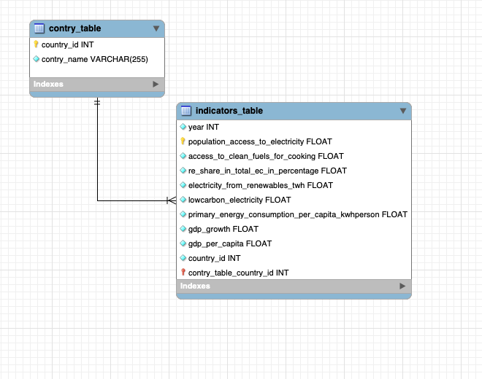
Chosen data, challenges and ERD
Dataset used: Global Data on Sustainable Energy (2000-2020). Sources: World Bank, International Energy Agency, and ourworldindata.org 195 countries in the world but in database 173 were part of the study.
Challenges:
Defining how to arrange the data in different tables.
Data wrangling in Python for uploading in My SQL
Too much time to figure out how to populate data

Slide 4
SQL Queries

Slide 5
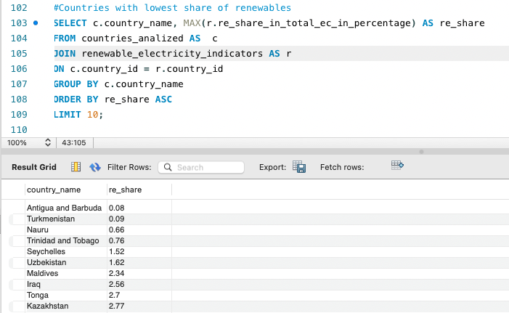
Countries with the lowest share of renewables

Slide 6
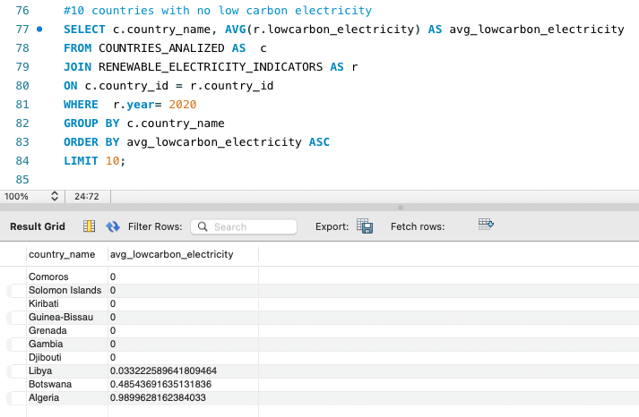
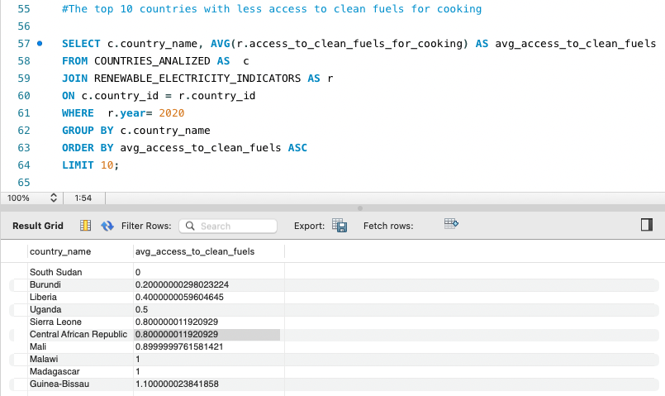
Countries with the lowest access to clean fuels for cooking and no low carbon electricity

Slide 7
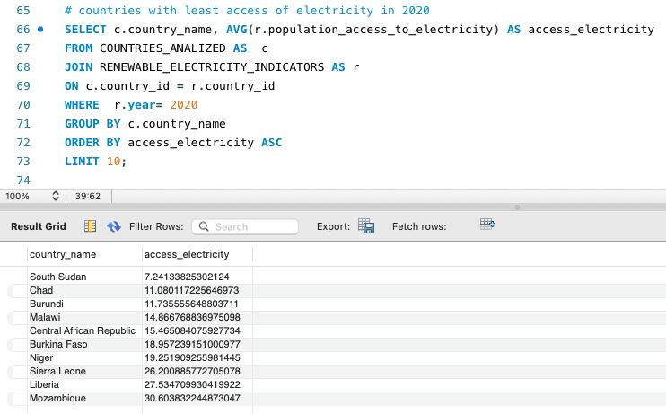
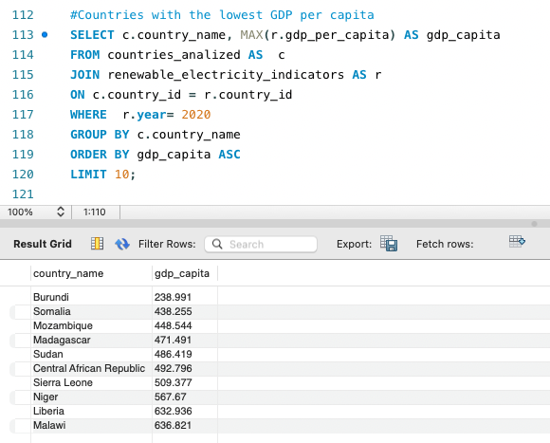
Countries with low access of electricity also are among countries with less GDP per capita

Slide 8
Visualization with Tableau

Slide 9
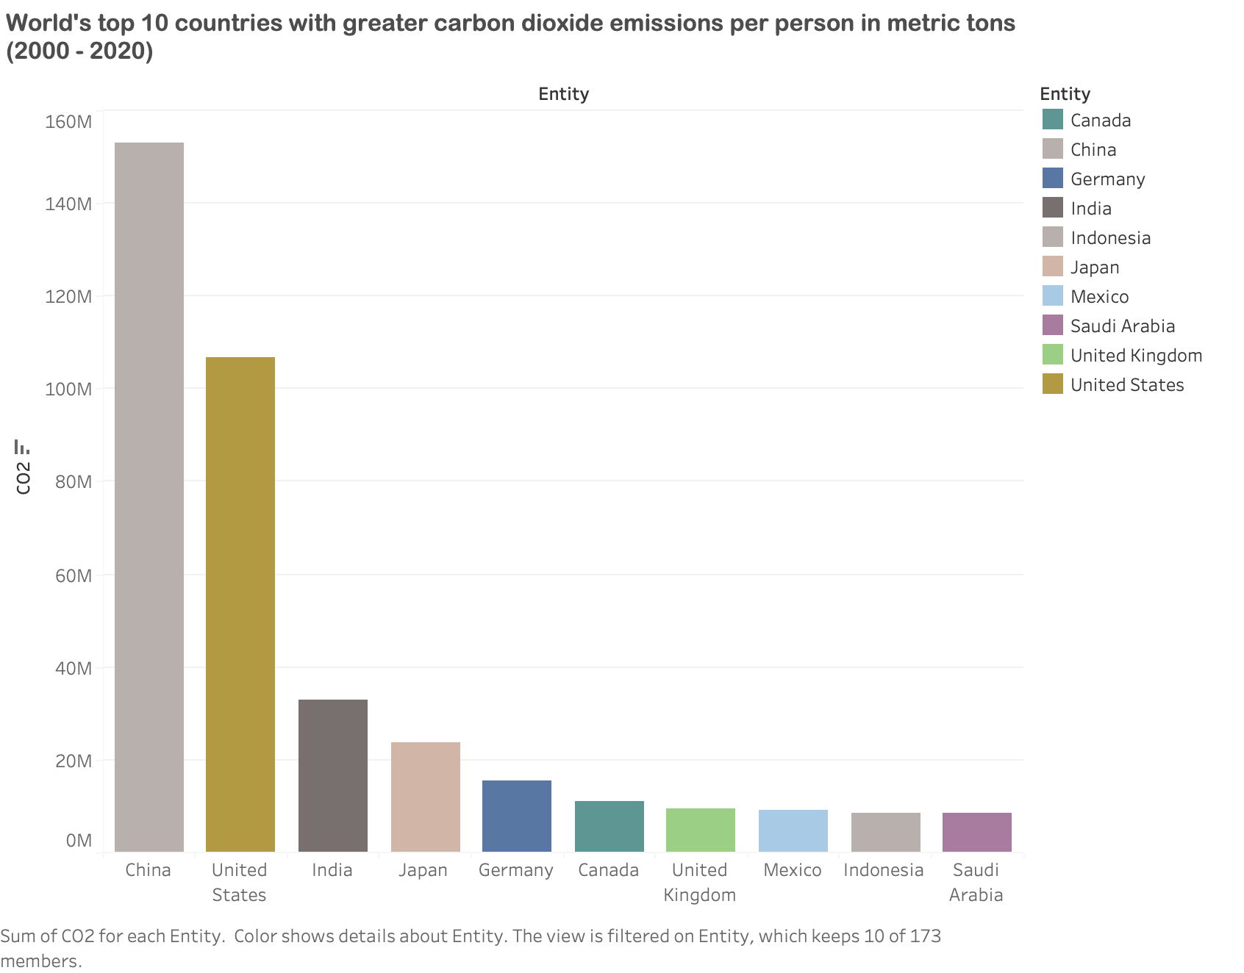

Slide 10
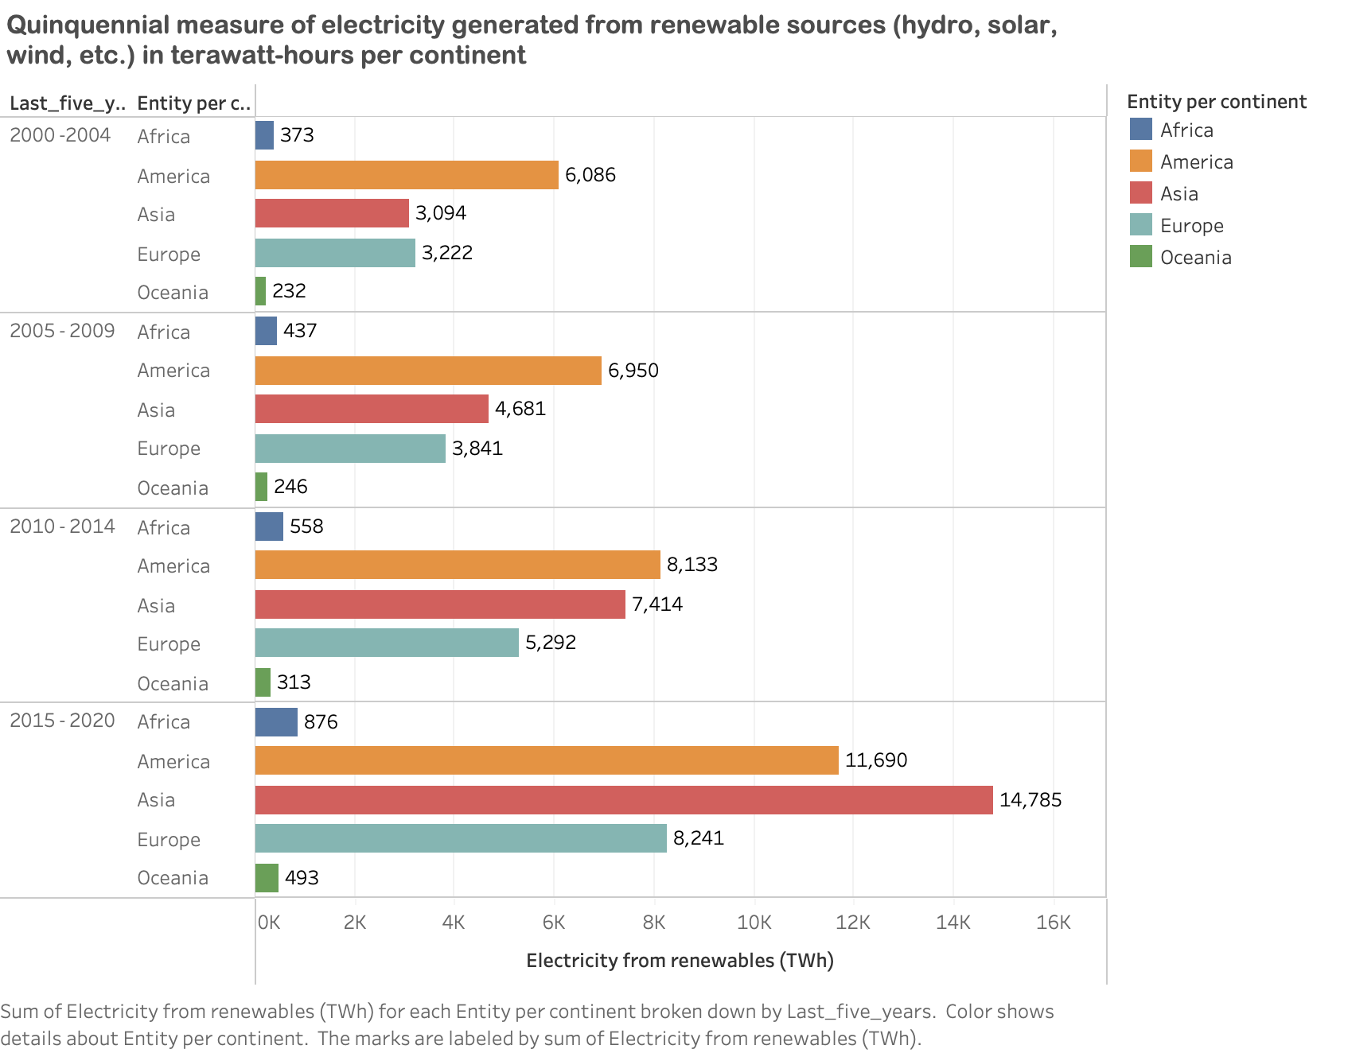

Slide 11
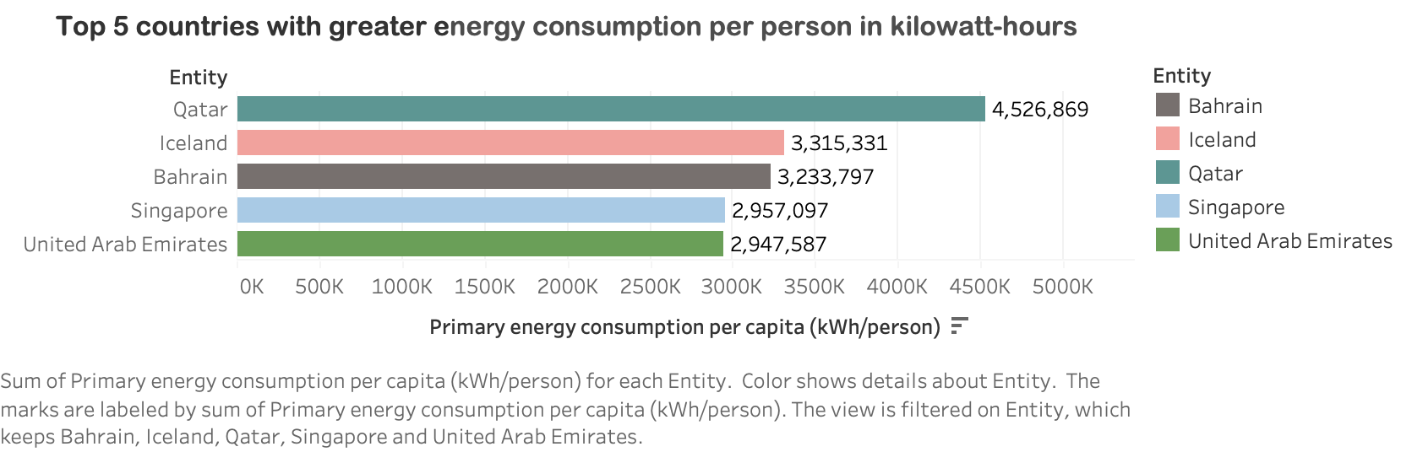
Notes:
Needed: GDP per capita for this countries in 2020

Slide 12
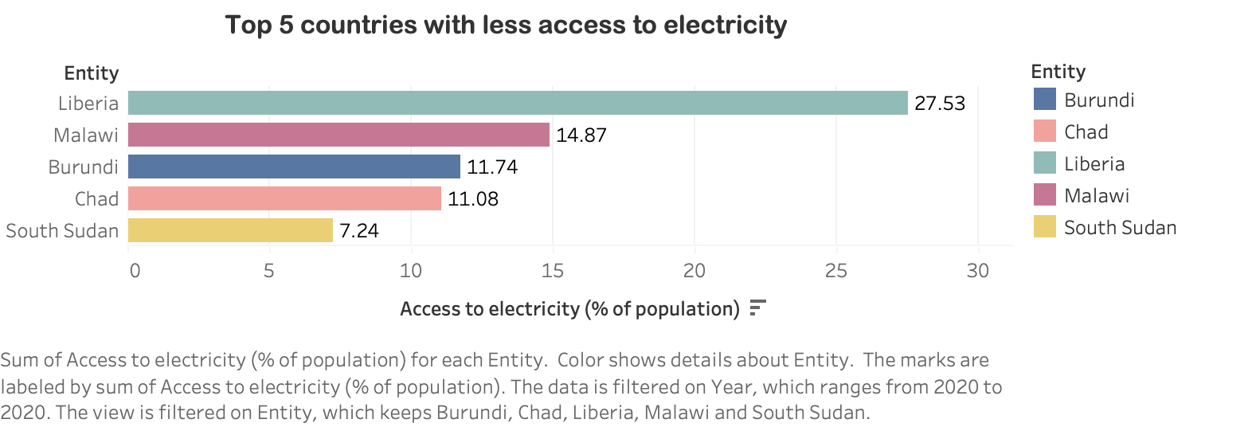
Notes:
GDP per capita for this countries in 2020

Slide 13
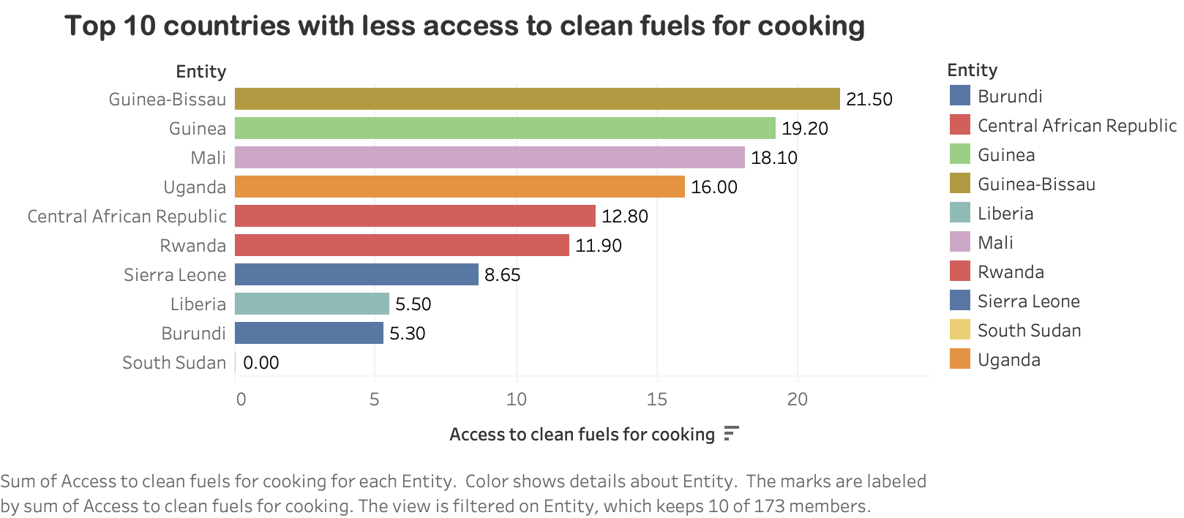

Slide 14
Conclusions & Business implications
The region with less access to electricity (and including clean fuel for cooking) is Africa and according to GDP measures, it is also reported with lowest growth.
Countries such as Qatar, Iceland and Singapore are reported with greater energy consumption, so these countries are potential targets, taking into consideration its GDP per capita.
The countries with lowest electricity access could benefit the most by renewable energies and potentially increase their GDP.
FUNDING NEEDED

Slide 15
Major Obstacles
Technical complexity of the selected database.
Learning to use My SQL workbench in a short period of time.
Some retrieved data from SQL was not consistent with what we saw from tableau. Need more time to solve this.
Health and time constraints.

Slide 16
Thank you!

